Slide 1
The Opacity of Animal Experimentation in the Commonwealth
April 3, 2025
Will Lowrey
Legal Counsel
Credit: Materials compiled with the invaluable assistance of PETA

Slide 2
Agenda
Overview of the problem
Public sentiment toward animals in experimentation
The state of animals used in experimentation in Virginia
Deficiencies with animal experimentation oversight and transparency
Recurring roadblocks
Legislative efforts to improve transparency
Conclusion

Slide 3
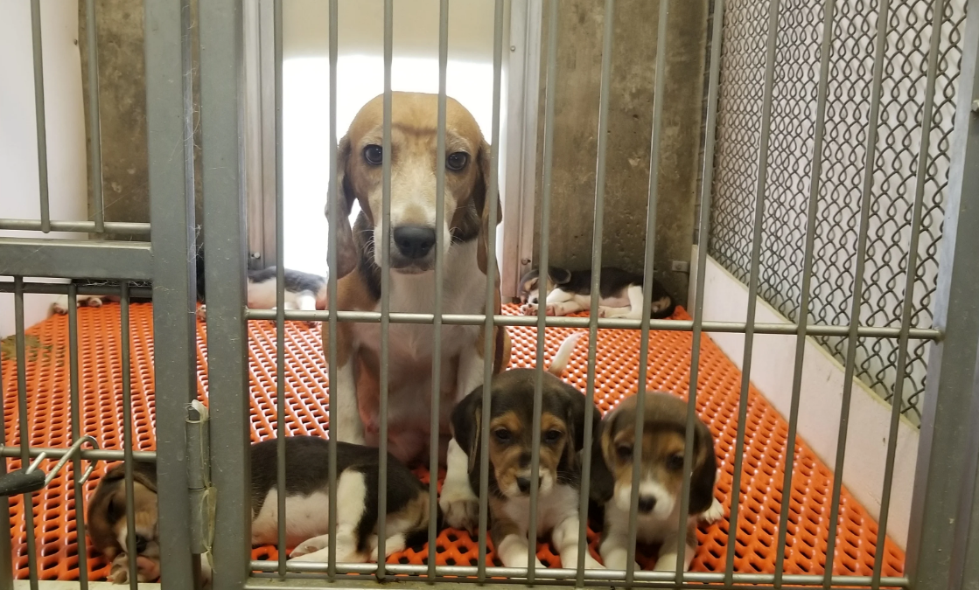
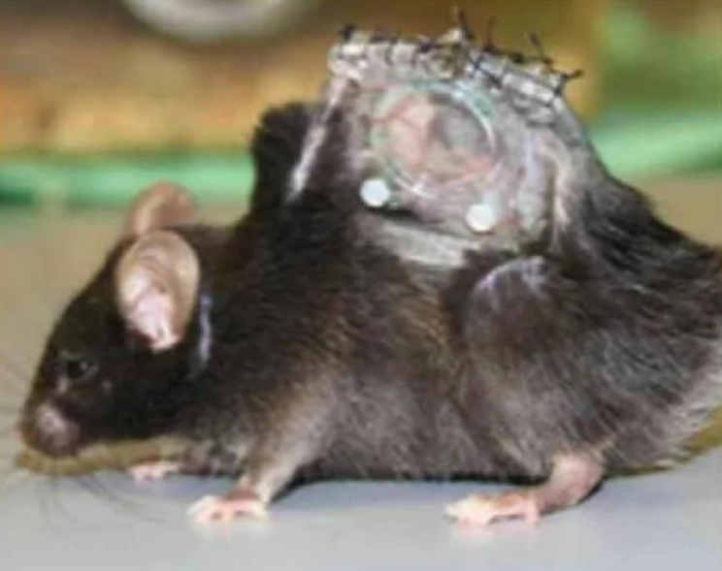
Public visibility into animal testing in Virginia is deficient
More than two dozen facilities—most of which receive some public funding—use animals in experiments in Virginia.
Animal experimentation is an issue of great importance to the general public.
Critical information pertaining to the numbers, use, and care of these animals remains hidden from the public, even when those animals suffer and/or die because of animal welfare violations due to:
Lack of consistent, comprehensive reporting requirements
Resistance from animal testing facilities to improve transparency
Photo credits: PETA

Slide 4
The public cares deeply about animals used in experimentation
A 2018 Pew Research survey showed that 52% of Americans oppose the use of animals in experiments.
A 2024 Morning Consult survey of 2,205 Americans found that 85% want animal experimentation to be phased out in favor of more modern methods.
Animal protection NGOs are funded by private donations from millions of people who rely on these groups to fight for transparency and justice.
In December 2022, the FDA Modernization Act 2.0 was signed into law, eliminating the requirement that new drugs be tested on animals, and the NIH convened a group to assist the institution in “prioritizing the development and use of NAMs,” also known as New Approach Methodologies or Non-Animal Methods.
Over the last 10 years, eight European countries have signed national Transparency Agreements, pledging to provide the public with crucial information relating to experiments using animals.
“ The rationale is that more transparency will increase public confidence in the appropriate conduct and regulation of animal research and therefore help to maintain public acceptance.” –Varga et al

Slide 5
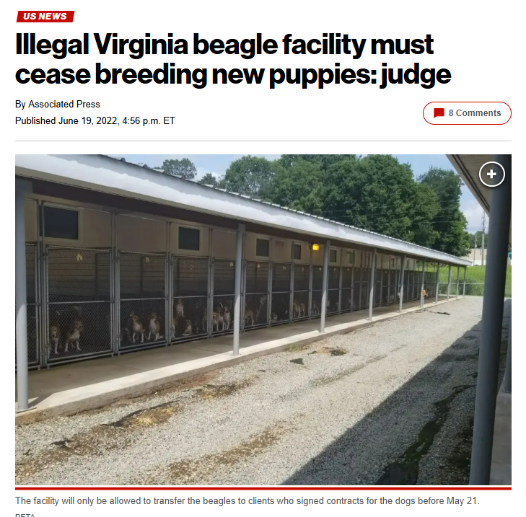
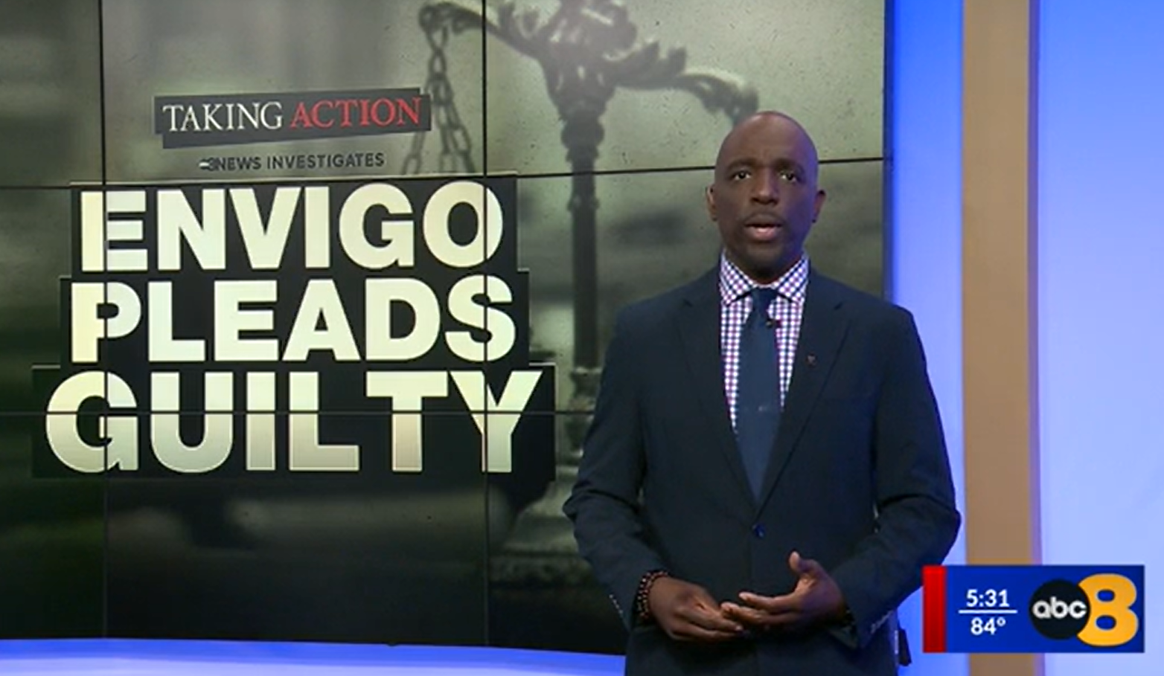
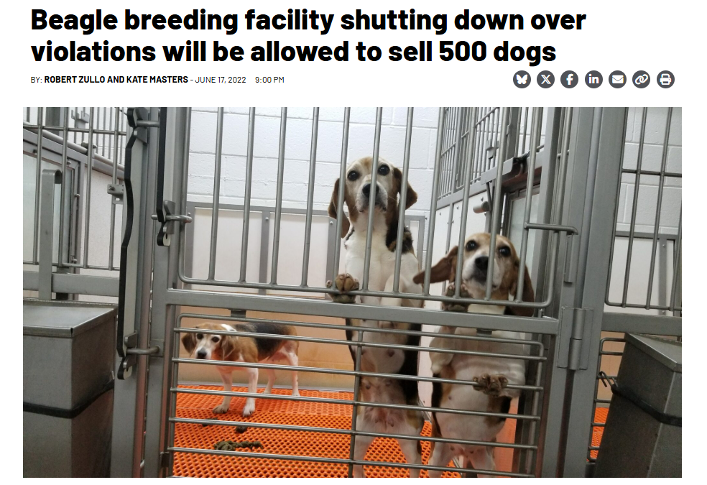
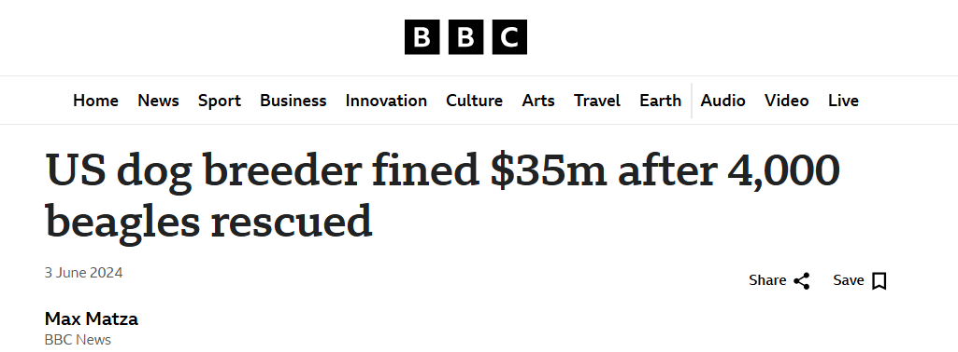
Envigo’s breeding facility incurred charges, fines, and public outrage over the neglect of thousands of dogs

Slide 6
Limited information is available through FOIA requests to federal oversight agencies
Two federal agencies—U.S. Department of Agriculture’s (USDA) Animal and Plant Health Inspection Service (APHIS) and the National Institutes of Health’s (NIH) Office of Laboratory Animal Welfare (OLAW)—regulate compliance with federal animal welfare standards at animal testing facilities.
USDA APHIS enforces the Animal Welfare Act (AWA), the only federal law intended to protect animals used in experiments, but it only applies to a small fraction of the animals used.
NIH OLAW requires facilities to adhere to guidelines set forth in the PHS Policy on Humane Care and Use of Laboratory Animals, but these guidelines are mostly recommendations, not requirements, and do not have the force of law.
OLAW records and certain APHIS records, including some pertaining to federal violations, can only be obtained via FOIA requests.
This process is often costly as well as time-consuming.
Fulfillment of requests to federal agencies can take months—even years—hindering timeliness, relevance and effectiveness of efforts to improve and advance animal welfare.

Slide 7
Federal oversight agencies have limited scope and little interest in enforcing laws/policies
USDA APHIS
NIH OLAW
APHIS enforces the AWA which does not include rats, mice, birds bred for research, or cold-blooded animals—e.g., fish, reptiles, and crustaceans. Approximately 95% of species used in experiments are not covered.
In 2005, the USDA’s Office of Inspector General (OIG) found that APHIS was “not aggressively pursuing enforcement actions against violators of AWA” and that “the fines are usually minimal and not always effective in preventing subsequent violations.”
As of 2019, APHIS had only 66 Veterinary Medical Officers to annually inspect over 850 research facilities.
When the AWA was first passed, the USDA resisted efforts to task it with its enforcement.
OLAW oversees all public and private facilities that receive NIH funding for activities involving vertebrate animals only per the Health Research Extension Act of 1985.
To receive NIH funding, a facility must obtain an Animal Welfare Assurance, an agreement between the facility and OLAW. Virginia public universities have chosen to have their Assurances apply only to animals used in federally funded experiments.
Animal testing facilities only need to report the “total number of animals proposed,” and serious violations are self-reported by the institutions. OLAW does not inspect or fine entities.
OLAW has only suspended one domestic PHS Assurance since 1986, when they halted all experimentation on vertebrates at Columbia University over “deficiencies in four general areas,” including the sterility of post-surgical recovery areas. The suspension only applied to “warm-blooded vertebrates, with the exception of rodents,” and it was lifted less than five months later.

Slide 8
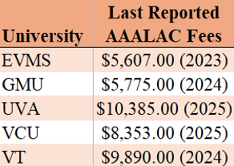
Private accreditation standards are weak and records are not readily available
The Association for Assessment and Accreditation of Laboratory Animal Care (AAALAC) is a private organization that offers an expensive “accreditation” program for facilities.
AAALAC records are not publicly accessible. AAALAC’s Council on Accreditation is made up of people who work at the very facilities the organization accredits – including a representative from Virginia Tech.
Accredited facilities must submit an annual report of all animals used in experiments, but these numbers do not include animals held and/or bred during the reporting period. This information is not publicly posted.
AAALAC conducts site visits which are scheduled in advance, and only every 3 years.
Envigo was AAALAC-accredited.
Virginia Tech is AAALAC-accredited, and they were in good standing with AAALAC when they were fined $18,950 by the USDA.
One study showed that “AAALAC-accredited sites had more AWA NCIs [noncompliant items] on average compared with non-accredited sites. AAALAC-accredited sites also had more NCIs related to improper veterinary care, personnel qualifications, and animal husbandry.”

Slide 9
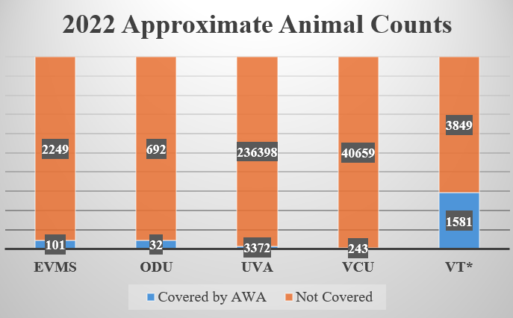
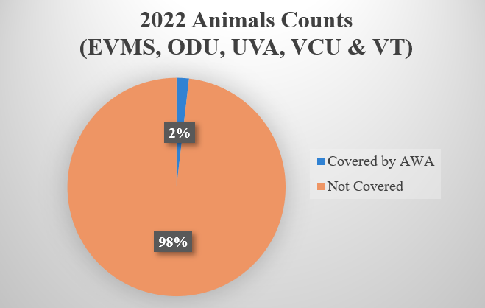
Hundreds of thousands of animals are used in experiments at publicly funded Virginia universities
In 2023, PETA submitted FOIA requests to AAALAC-accredited public universities in Virginia to obtain the approximate number of animals they used in experiments, including those not reported to USDA APHIS. These records show that the overwhelming number of animals who are experimented on are not federally covered, and information about their numbers, care, and use is not made publicly available.
*VT’s count included “ rodent cages” and “fish tanks” instead of animals, so the number of animals not covered by the AWA is far higher. These numbers do not include animals held but not used in protocols.
Mice, rats, fish, captive-bred birds, reptiles, amphibians, and cephalopods accounted for the species used in experiments who are not federally protected.

Slide 10
Virginia Tech received one of the largest fines in recent history for AWA violations
On March 21, 2024, Virginia Tech entered into a settlement agreement with the USDA over repeated violations of the AWA. Virginia Tech agreed to pay a fine of $18,950, one of the largest fines issued by the USDA in recent memory.
Issues that formed the basis of the fine were serious and included:
Mishandling animals during procedures
Failure to notify veterinary staff of issues
Failure to ensure proper feed/nutrition
Despite Virginia Code § 3.2-6593.2(C) which requires institutions to post inspection reports and “any other relevant U.S. Department of Agriculture incident reports and relevant documents generated from internal reviews” publicly on its website, Virginia Tech did not post any notice of this settlement. Virginia Tech asserted it was not required by law to post this report despite its severity and the wording of the law.

Slide 11
Virginia institutions repeatedly violate OLAW policies (but information is difficult to obtain)
The following self-reported violations were obtained only via FOIA requests, and many detail unnecessary suffering and painful deaths due to lab staff negligence. None were publicly posted.
From May 2019 to June 2024, VCU self-reported 16 separate violations where a lack of food and/or water resulted in the deaths of at least 69 mice from starvation and/or dehydration.
From June 2020 to April 2024, UVA self-reported 11 separate violations where incomplete surgery cage cards lacked critical information pertaining to the administration of pain-relieving medication and/or the required number of post-operative observations, affecting at least 303 mice and an additional eight cages of mice.
In February 2023, VT self-reported that a wild-caught bird “was inadvertently left in a holding crate and died.”
In February 2020, EVMS self-reported that eight weanling mice were found dead because they were not “able to reach the food.” Six months later, two mice died because they could not access their water.

Slide 12
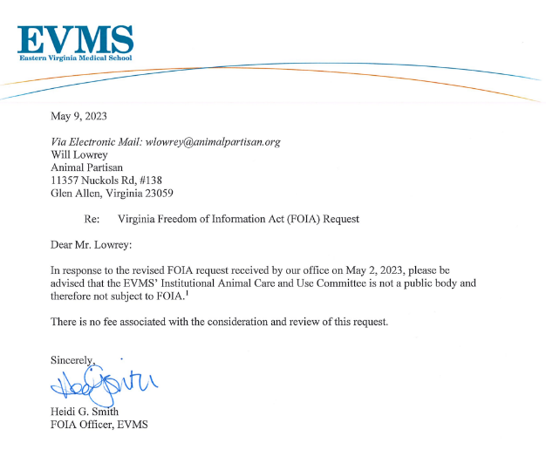
IACUCs are intended to oversee animal welfare, but they are ineffective and opaque
Institutional Animal Care and Use Committees (IACUCs) are oversight bodies within individual institutions that are responsible for ensuring that animal-use protocols adhere to the AWA and/or the PHS Policy.
Many protocols are reviewed only by one member.
IACUC transparency is inconsistent, and the required makeup of the IACUC body allows for bias.
Only one person who is not affiliated with the institution is required.
Many members are paid employees of the institution, and up to three members can work in the same department.
OIG audits have shown that IACUC oversight is inadequate. For example, in 2014, OIG highlighted that from 2009 to 2011, USDA inspectors cited 531 experimentation facilities for 1,379 violations stemming from the IACUCs’ failure to adequately review and monitor the use of animals.
Universities have frequently claimed that an IACUC is not a “public body” and therefore not subject to VFOIA.
Universities have refused to provide the names of IACUC members (because of university “practice” and not VFOIA)

Slide 13
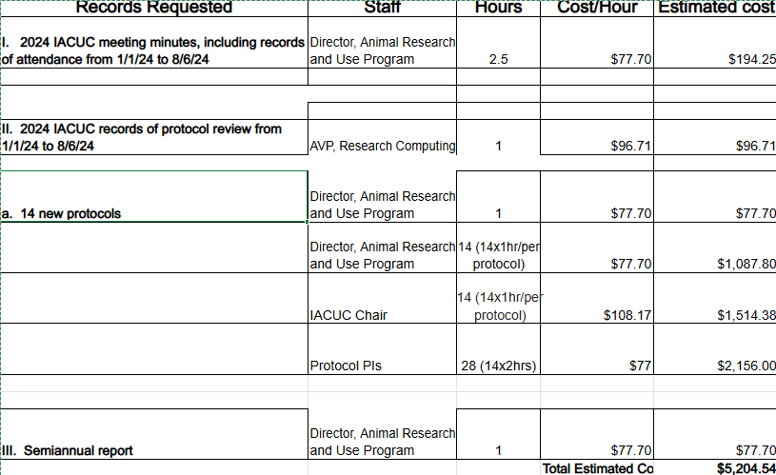
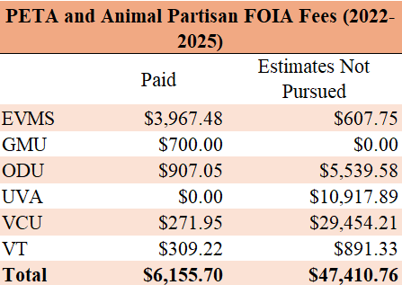
Universities regularly charge excessive fees to obstruct transparency into animal experimentation activities
UVA
VCU

Slide 14
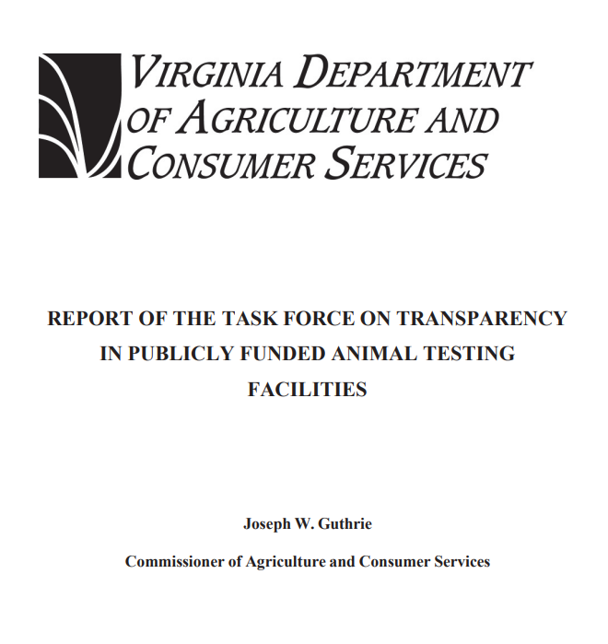
The General Assembly convened a Task Force to examine deficiencies in transparency
In the 2024 General Assembly, a bill was passed to form the Task Force on Transparency in Publicly Funded Animal Testing Facilities “for the purpose of identifying potential deficiencies in publicly funded animal testing facilities”
The Task Force was comprised of legislators and stakeholders, including representatives from Virginia universities, animal protection “watchdog” groups, representatives from the Virginia Coalition for Open Government, the Virginia Press Association, and others.
The Task Force met four times in late 2024, totaling over 10 hours of meetings.
The Task Force achieved consensus on one item: that the Virginia State Council on Higher Education (SCHEV) would serve as a better host for any reports on animal testing than the Virginia Department of Agriculture and Consumer Services (VDACS)
No other proposal achieved consensus (although some came close), including proposals for various reports such as: (1) progress toward the 3Rs, (2) total number of animals, (3) adverse events, and (4) disposition of animals
SB1481 was spawned from the Task Force and although it did not pass, it evinced that legislators viewed transparency as an important issue
“The very least we can do as legislators is actually have some data and accountability for our actions, because we are the ones who are responsible for whether they live or die at the end of the day.” – Senator Danica Roem

Slide 15
Many other states have attempted to improve transparency into animal research
California: The Transparency in Research Act was introduced in 2019 and would have required that state-funded institutions disclose information about their animal research activities, including the species and number of animals used.
Colorado: SB24-067 was introduced this year and would have required that animal testing facilities submit an annual report to the Colorado Department of Public Health & Environment containing the total number of animals used in experiments, including those held and bred but not used in protocols.
Florida: SB368 was introduced this year and would have required that animal testing facilities submit an annual report to the Florida Department of Agriculture and Consumer Services containing the total number of animals used for experimentation and their use per species.
Indiana: HB1292 was introduced this year and would have required that the Indiana State Board of Animal Health establish a registry of animal testing facilities and “track the number of live animals” used in experiments at each facility.
Maryland: In 2023, SB0495 was introduced and would have required that animal testing facilities submit an annual report to the Maryland Department of Agriculture containing the “number of each species of vertebrate animals owned and used” by the facility.
Missouri: SB1319 was introduced this year and is up for a House hearing. If passed, the bill would require that universities that receive state funding post annually on their websites critical information pertaining to animal testing, including total funding used, funding sources, active protocols, documents related to AWA violations, efforts to adhere to the 3Rs, species of animals used, and animal counts. The animal counts would be required to include the total number of animals adopted out from laboratories as well as the number of animals euthanized.
Washington: HB2304 was introduced this year and would have required that the University of Washington’s (UW) Washington National Primate Research Center publish information annually pertaining to experiments involving nonhuman primates, including the number of primates used in experiments and for breeding purposes as well as any who were injured or died in relation to USDA citations and any who were killed or died while on protocol.

Slide 16
Some states have succeeded in passing laws to improve transparency
California: California requires that institutions that do not receive funding from the NIH submit an application to the California Department of Public Health if they intend to use animals not covered under the AWA. Along with the application, they must also report the number and source of mice, rats, and other noncovered animals they intend to use.
Massachusetts: The city of Cambridge, where Harvard University and MIT are located, passed a law in 1989 requiring that any institution planning to conduct experiments on vertebrate animals must apply for a permit. All laboratories are inspected annually by the commissioner of laboratory animals, who also reviews research programs, protocols, and procedures. The law requires that during the annual visit, institutions provide information on the number and species of animals used.
New York: The Public Health Act requires that all research facilities that test on animals be annually approved by the New York Department of Health Commissioner, and they are also subject to inspection by the health department. Additionally, “[o]nly laboratories that hold a New York State clinical laboratory permit are authorized to perform testing on specimens originating from New York,” adding another layer of oversight.
Oregon: An Oregon law requires that Oregon Health & Science University, where the Oregon National Primate Research Center is located, publish information annually pertaining to experiments involving nonhuman primates (NHPs), including the number of primates used in experiments and for breeding purposes as well as any who were injured or died in relation to USDA citations. This new legislation came about after many years of the USDA citing the university for federal animal welfare violations.

Slide 17
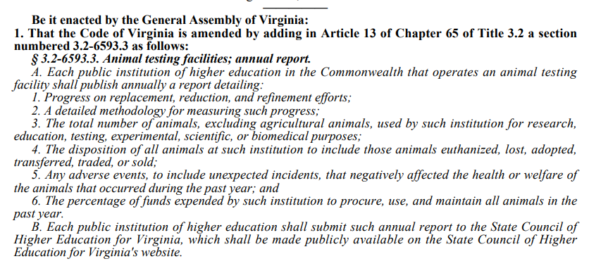
Transparency bills introduced in 2025 had limited success
SB1481 attempted to fulfill several recommendations of the Task Force but failed. Institutions proposed a fiscal impact of “$1.0 - $2.3 million in one-time costs and approximately $100,000 - $900,000 in ongoing costs per institution.”
SB1127 passed both chambers unanimously and successfully amended Virginia Code § 3.2-6593.2(C) and broadened the scope of records institutions must proactively publish

Slide 18
Conclusion
Hundreds of thousands of animals are used in experimentation across the Commonwealth
The public cares about their use, their welfare, and plans to move away from animal experimentation
These animals are routinely subjected to mistreatment
Current law makes it extremely difficult to gain visibility into the use of animals
Efforts to improve or gain transparency have repeatedly encountered obstacles and impediments imposed by Virginia’s animal research facilities
We expect future legislative efforts to try and implement Task Force recommendations

